Slide 1
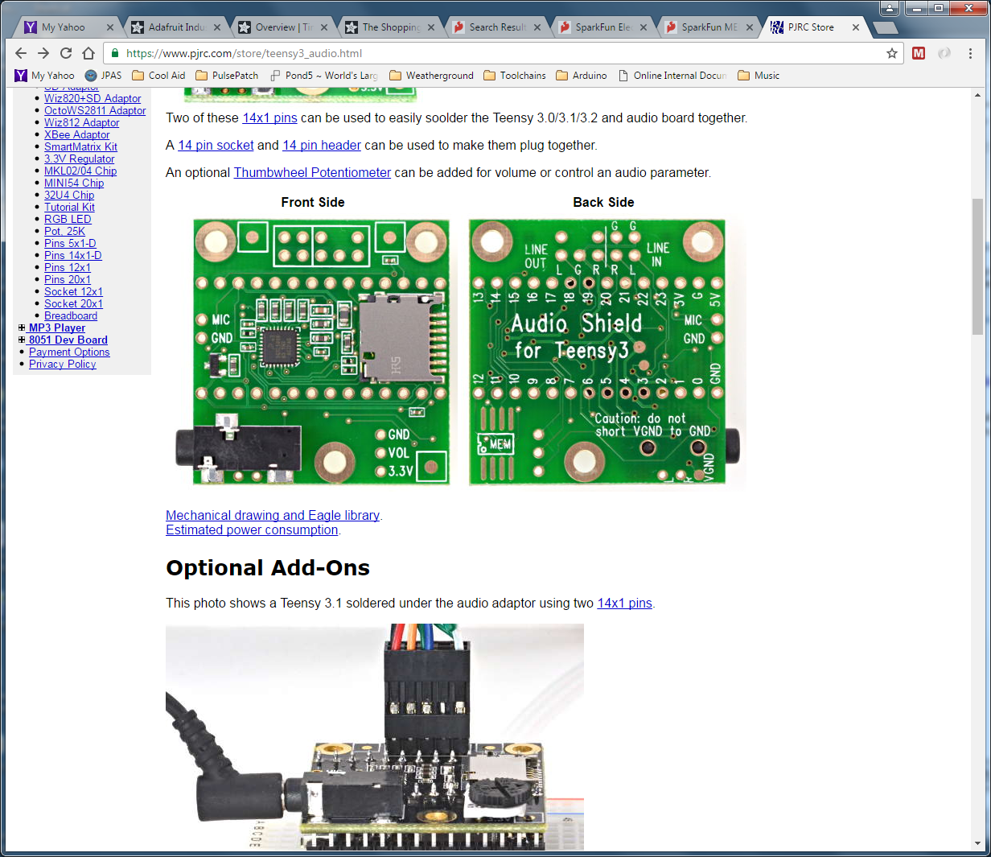
New
“Line In”
1/8” Phono Jack
Tip
Ring
Sleeve
“Mic In”
1/8” Phono Jack
Tip
Ring
Sleeve
Install Pot

Slide 2
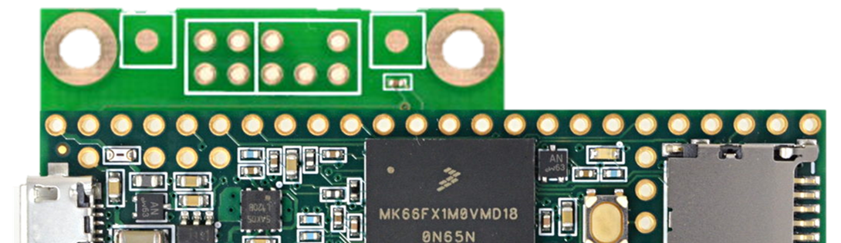
Also, grab “3V” and bring out to pin or to wire
Backside View
Add Header (Male Pins?)
To the “Line In”

Slide 3
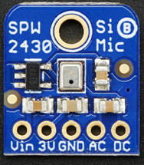
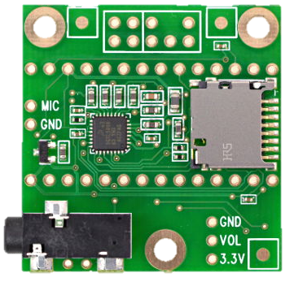

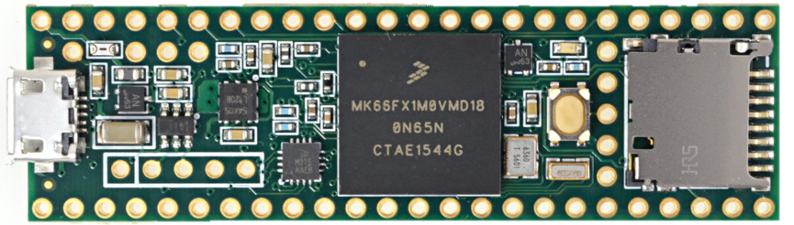
Mount Mic to the plastic base
Mount Mic to the plastic base
Mating
header
Mating
header
The new
header
Left
Right
To “Vin”
Not “3V”
Another “3V”
Wire
The “3V”
Wire

